Slide 1
Roles and responsibilities of the Respect Marshall Shropshire Junior Football League (Shropshire FA)

Slide 2
Respect Marshall
It is the responsibility of every Club Affiliated to the Shropshire Junior Football League (and Shropshire FA) to provide match-day Respect Marshall(s) for all their home fixtures governed by the league
(implemented from season 2015-2016)

Slide 3
Who should carry out the RM role?
Not the Manager or Coaching Staff.
An Adult/club member (16+) who preferably is someone that is calm but confident in dealing with others within their own Club.
Try to keep the same person every week or a small group of people to carry out the role on a rotational basis.
Make sure they are known to supporters of your team.

Slide 4
Appropriate Attire for Club Respect Marshall
Do I need to wear a fluorescent jacket or visible clothing?

Slide 5
Visibility
How easier it is for the Referee to SPOT the
Respect Marshall in this group of people?

Slide 6
Prior to each game the Respect Marshalls (RM) will introduce themselves to each other and to the Referee and make him/her feel welcome. Home RM will direct the Referee to their changing rooms (if applicable), to the correct pitch, ensure their fees are paid at the end of the game and, if required, escort them safely as they leave the venue.

Slide 7
RM’s Responsibilities
Ensuring own spectators comply with the Respect designated spectator area.
Remind own supporters of responsibilities in relation to Respect.
Support the Referee when dealing with any spectator related issue within your own team.
Use common sense at all times and be a visual point of contact for any concerns from the opposition RM
Dependent on League procedures the RM may assist to check registration forms and/or complete match respect result forms.
The FA Respect Programme/Code must be followed by the RM at all times, and any related issues should be reported through your club CWO/Secretary to the League and/or County Association to be dealt with.

Slide 8
Match-Day Respect Marshall and Respect
The Match-Day RM can help the Club ensure that the Respect Code/Programme is followed for the benefit of all participants. RMs should use their knowledge of their own Club spectators to help prevent any abuse, foul language or other unacceptable behaviour. The RM should ensure their own safety at all times and if in doubt about the potential for a situation to escalate they should act in accordance with their concerns.

Slide 9
Working Collectively Together
Lets all work together
to
avoid this!

Slide 10
Non Adherence !!

Slide 11
Compliance
And see
more of
this

Slide 12
Compliance

Slide 13
Compliance
And lots
more of
these

Slide 14
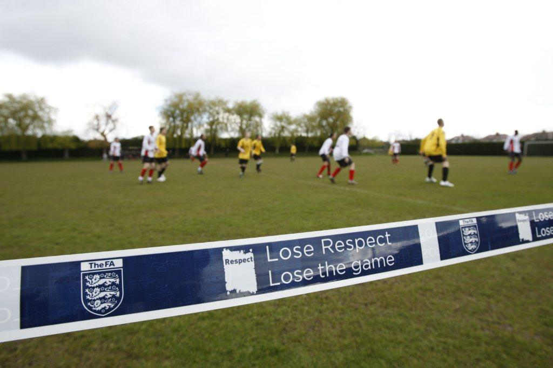
Designated Spectator Areas
Poles with ropes or tapes
Cones
Line markings
Banners / Signs
Poster Boards

Slide 15
Designated spectator areas
RMs to hold Accepted Enhanced Criminal Records Check / with the FA DBS
Managers, Coaches, Phyio/ Medics, Substitutes.
Assistant Referee Technical Area (managers)
NO GO AREA
NO GO AREA
2 metres
Assistant Referee
Spectators/ Parents/ Guardians

Slide 16
Reporting Related Concerns
Your Club Welfare Officer
Your League Welfare Officer – Jan Butler:
sjflwelfareofficer@btinternet.com
SFA County Welfare Officer - Dai Lewis: david.lewis@shropshirefa.com
Referee Development Officer - Jamie James:
Jamie.James@shropshirefa.com

Slide 17
Additional resources/help
Codes of Conduct (The FA.com/Respect)
http://shropshirejuniorleague.co.uk/code-of-conduct/
http://shropshirejuniorleague.co.uk/protection/
Captain’s Guide.
Respect Code – Young Players
Parents & Carers Guide (The FA.com/Respect)
Club Referee and Assistant workshops.

Slide 19
Any further Questions or Enquiries please contact SJFL: Jan Butler: sjflwelfareofficer@btinternet.com or league website www.shropshirejuniorleague.co.uk (contact-us) or SFA Lead Respect Officer - Dai Lewis: david.lewis@shropshirefa.com )

